Slide 1
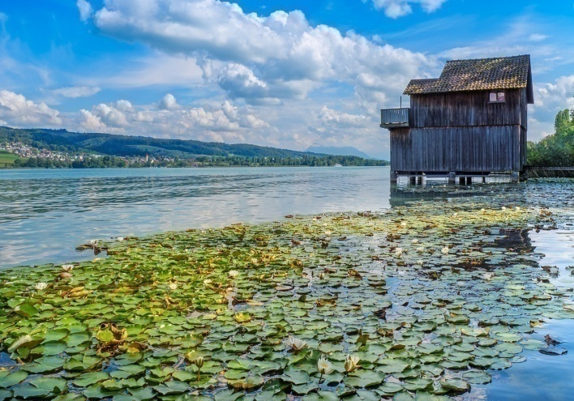
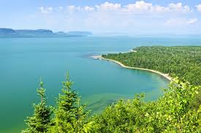
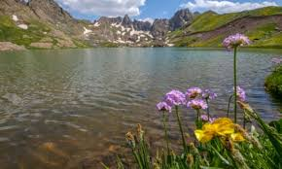
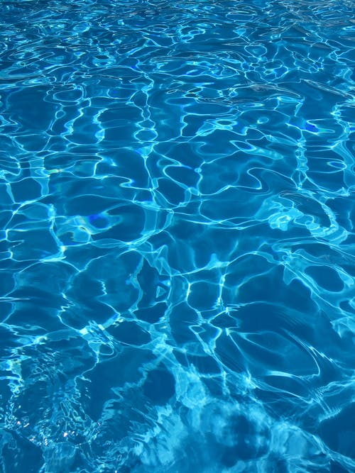

Pond Biotex
MICROBES FOR LAKE AND POND CLEANER
INTRODUCTION
Lakes and ponds are complex ecosystems that require monitoring and care to stay healthy. Whether you use your lake or pond for recreation, for fish or as an attractive addition to your property, there are several issues you probably encounter with its maintenance.

Slide 2
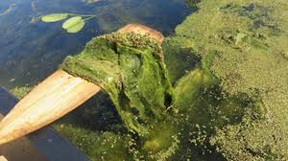
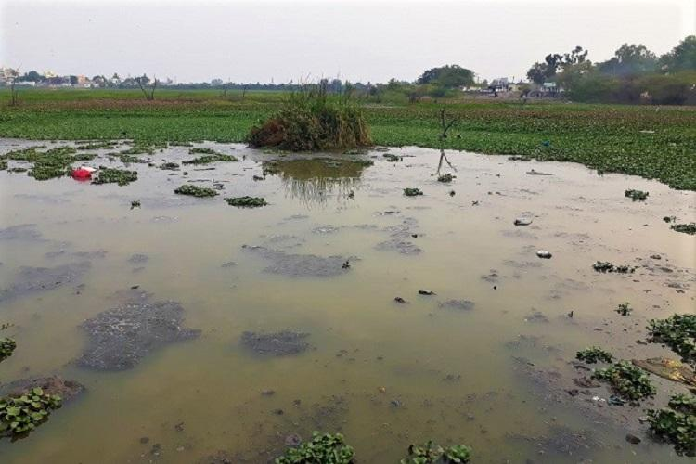
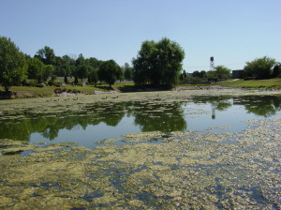
Common Lake & Pond Problems
1. FILAMENTOS/BLUE GREEN ALGAE
Also known as Pond scum, Filamentos/Blue green Algae grow excessively when nutrients such as phosphorus and nitrogen are abundant.
They can contain microcystin and other toxins, which are potentially hazardous and can contaminate lake and pond water can also be harmful to fish populations and other inhabitants of your pond.

Slide 3
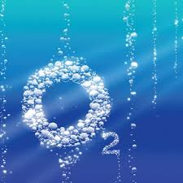
Common Lake & Pond Problems
2. OXYGEN DEPLATION
Most fish require dissolved oxygen levels of at least 1 mg/l, though levels should be maintained at four milligrams per liter, When levels dip below one milligram per liter, even for a few hours, it can result in rapid Fish population collapse. For this reason, monitoring dissolved oxygen levels is one of the key components of lake and pond maintenance. There are several reasons why oxygen content may drop suddenly, including: 1.PLANTONIC ALGAE BLOOM
2.OVER ABUNDANT VEGETATION
3.DIED PLANTS

Slide 4
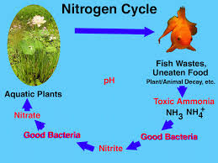
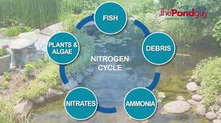
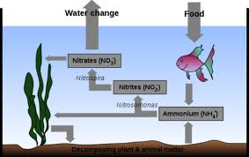
Common Lake & Pond Problems
3. HIGH AMMONIA
Ammonia is produced by fish waste and decomposing organic matter/sludge in the pond. Ammonia is harmful to fish When this occurs, remove as much debris as possible form the bottom of the pond by adding sludge-eating bacteria on a regular basis can eliminate this problem.

Slide 5
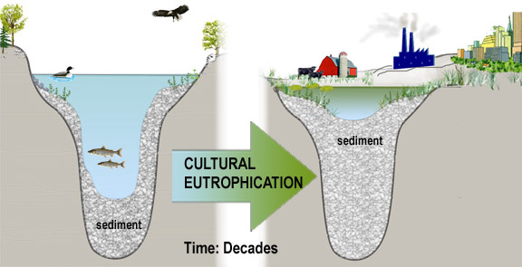

Common Lake & Pond Problems
4. CULTURAL EUTROPHICATION
Eutrophication comes from the Greek work for “over fed”and that’s just what plants are when they tend to grow to fast. Such ponds are overly fertile with plant food(Nitrates and phosphates) Oxygen depletion, or hypoxia is a common consequence of eutrophication, both in fresh water and seawater. The direct effects of hypoxia include fish kills.

Slide 6
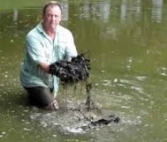
Common Lake & Pond Problems
5. POND BOTTOM SLUDGE
Sludge is simply an accumulation of organic debris that settles in the pond bottom. Most commonly the sludge will be a mixture of leaves, fish waste, decaying plant debris, dead algae, and debris washed into the pond with rain run off.
The Sludge decomposition process of the organic material will reduce oxygen levels in the pond. The debris will create anaerobic conditions. This oxygen-free zone can harbor harmful bacteria as well as produce hydrogen sulfide. The hydrogen sulfide will begin to cause harm to other living things in the pond environment. It also can create unpleasant odors in the pond.

Slide 7
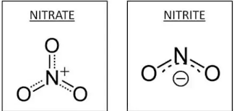
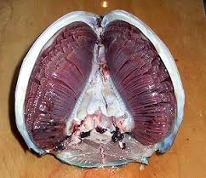
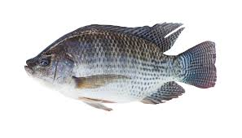
Common Lake & Pond Problems
5. NITRITE TOXICITY
Brown Blood Disease occurs in fish when water contains high nitrite concentrations. Nitrite enters the bloodstream through the gills and turns the blood to a chocolate-brown color. Hemoglobin, which transports oxygen in the blood, combines with nitrite to form Methemoglobin, which is incapable of oxygen transport. Brown blood cannot carry sufficient amounts of oxygen and affected fish
Warm water fishes like Corps, Catfishes, Tilapia are fairly sensitive to nitrite, and trout and other cool water fish are sensitive to extremely small amounts of nitrite.

Slide 8
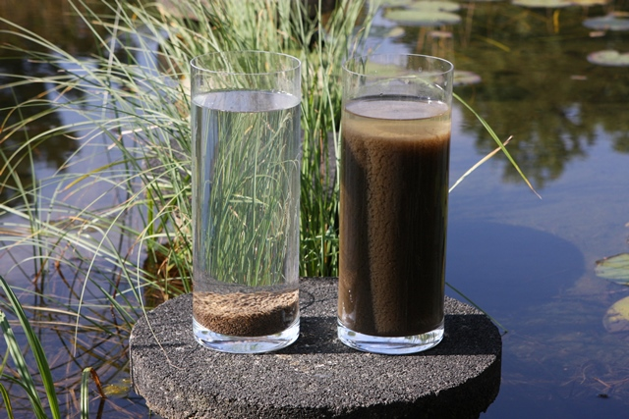

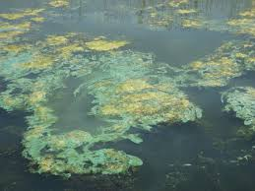
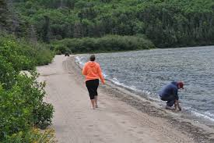

What is the solution to prevent you Lake & Pond

Slide 9

1. MONITOR THE WATER PARAMETERS
Please maintain water parameters and observe these parameters by testing lab or the farmers experience in order to control them with the optimum range
Parameter | Value
Dissolved Oxygen | 4 (mg/l)
pH | 7.5 - 8.5
Ammonia | <0.1 (mg/l)
Transparency | 30 - 45 (cm)

Slide 10
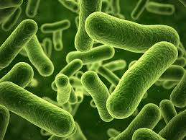
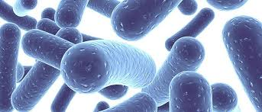
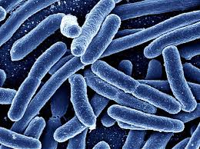
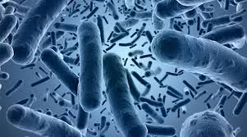

2. INTRODUCE BENEFICIAL MICROBES IN POND
Pond Biotex Lake&Pond Cleaner Beneficial Bacterial products work by digesting decaying matter and consuming nitrogen and phosphate.
Pond Biotex Digesting excess organic matter and consuming excess nutrients helps to balance your lake or pond and create a natural healthy environment.

Slide 11
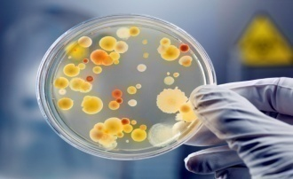
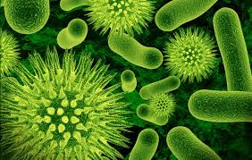
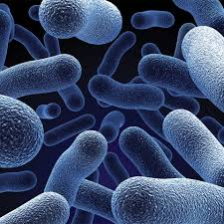
2. INTRODUCE BENEFICIAL MICROBES IN POND
Pond Biotex Creating a healthy aquatic environment and addressing the root cause of a lake or ponds problems also helps to limit the potential need for algae control treatments.
Pond Biotex Lake and pond cleaner can be used as a maintenance tool to clarify water or to treat a specific problem like high nitrogen levels or muck buildup. Depending on the pond environment.

Slide 12
How can be Pond Biotex improve your lake and Pond water Quality .?
Our safe, very effective and non-toxic Pond Biotex pond cleaning bacteria consists of millions and millions of beneficial bacteria that start eating dead, decaying organic matter such as fallen leaves, fish wastes, sludge, muck, pond slime, etc.All of these wastes provide food and nutrition for unwanted pond algae and causes it to grow. Pond Biotex to getting rid of pond algae is to add a good beneficial bacteria product to your pond or lake on a regular basis that continually eats the wastes without being toxic or harmful to the environment.

Slide 13

How can be Pond Biotex improve your lake and Pond water Quality .?
Pond Biotex is a proprietary composite biocatalyst that enhances a broad range of hydrolytic, oxidative and reductive biochemical reactions. Tex Lake and pond cleaner contains novel consortia of metabolically cooperative microorganisms, with endogenous and exogenous enzymes, and small molecule metabolic co-factors which support both biocatalytic and metabolic activity. Tex microclean products are composed of all natural materials and non-genetically modified.

Slide 14
How can be Pond Biotex improve your lake and Pond water Quality .?
Pond Biotex is Lake and Pond Cleaner is a completely natural and harmless method of controlling nitrates, phosphates, organic bottom sludge and odors.
Pond Biotex won't attack or eat live tissue or living plants. It's very safe and very effective
Pond Biotex are completely safe for the shrimp and fish as well as humans, animals, plants, birds and the environment.

Slide 15
How can be Pond Biotex improve your lake and Pond water Quality .?
Pond Biotex useful bacterial strains are grown and blended for application to specific organic problems and commercial uses and typically contain a number of species that have been selected and combined to degrade specific organic compounds or waste products
The strains of bacteria in the blend work together - each producing the enzymes necessary to degrade specific components in the waste and their resulting intermediates until reaching non-harmful compounds such as water and carbon dioxide.

Slide 16


BENEFITS OF Pond Biotex
Pond Biotex provides an easy- to-manage water treatment system that accelerates biological removal of detrimental nutrients from the water including ammonia and nitrites.
Pond Biotex works well in both aerated and un-aerated systems for consistent high-water quality.
Pond Biotex also has a unique capability to denitrify efficiently at high dissolved oxygen conditions typical of decorative water features.
Pond Biotex family of products is used in commercial aquaculture ponds, wastewater treatment, nutrient management and odor control.

Slide 17
BENEFITS OF Pond Biotex
Pond Biotex Lake and Pond Cleaner works in the entire water column, as well as bottom sludge layers, to digest any organic wastes generated by animal and plant life in the pond.
Reduces sludge buildup, and organic buildup in water body
Improves water quality, environment of water body
More efficient nitrogen cycle-decreased levels of ammonia(NH3) and nitrates(NO2)
Reduced odor levels
Reduced Bottom sludge accumulation
Reduced surfaces scum
Reduced need for pond clean –outs
Increased chlorine stability leading to reduce replacement of chlorine where used expense reduction

Slide 18
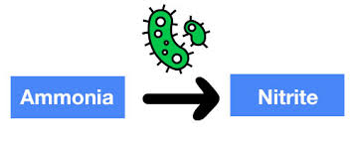
BENEFITS OF Pond Biotex
Reduced need for water exchange and aeration
Reduced need to empty and clean walls and sludge
No other sludge digesters, denitrifies etc. required
100 % Organic Product
Reduces algae, duck weeds
Dissolved Oxygen levels increased rapidly and stabilized
Reduced Energy use for aeration and pumping
Metabolizes nutrients

Slide 19
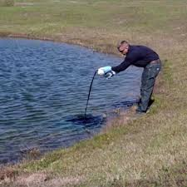

DOSAGE OF Pond Biotex
Dosing for most applications is recommended at 0.5mg/L every 2 weeks. Initial shock doses of 3.0mg/L are recommended for systems with high levels of organic material. Systems with high loading during summer months should be dosed at 1mg/L every 2 weeks. Dosing can be adjusted to meet treatment outcomes.

